Slide 1
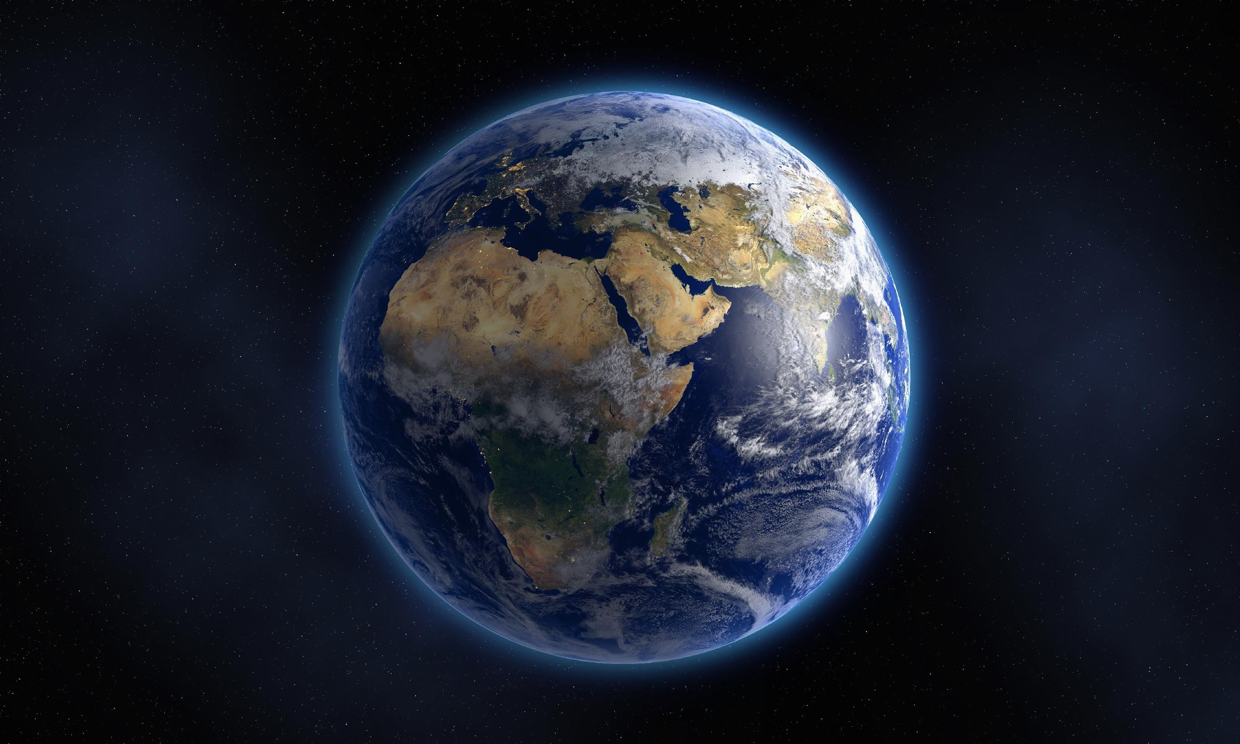
Artificial Cilia Creation for Advanced Sensor Devices
1
By: Ryan Evans
Northern Arizona University

Slide 2
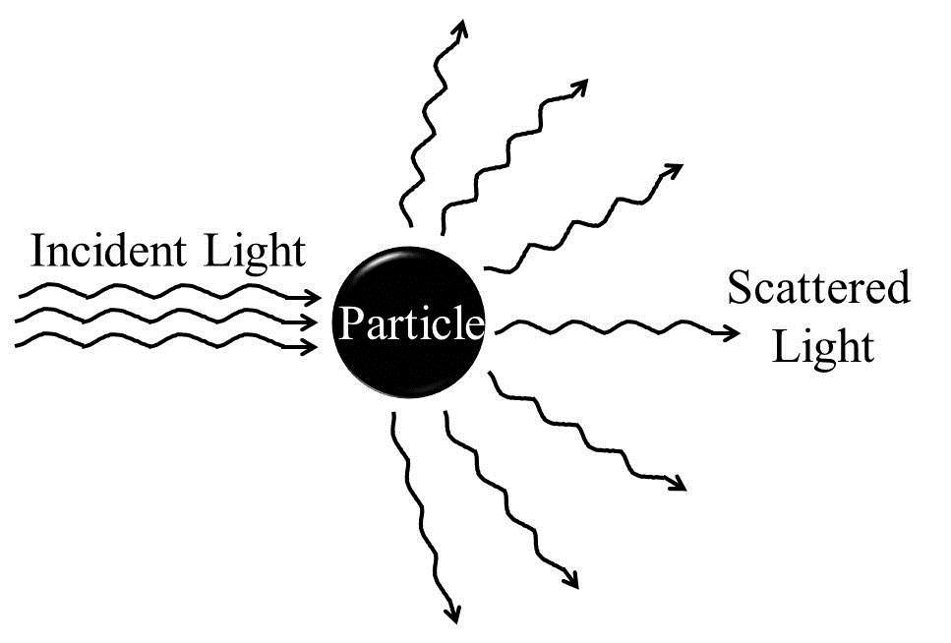
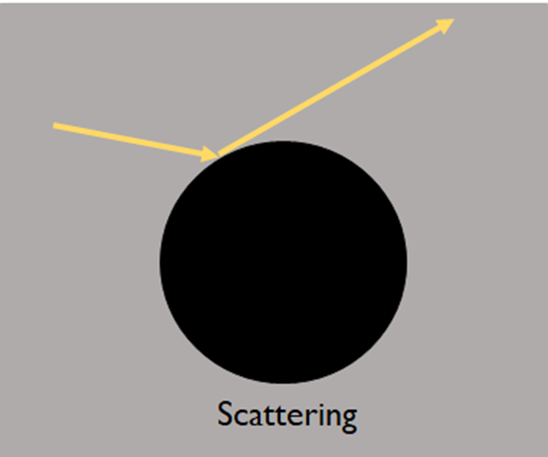
INFUSING PARTICLES INTO RESIN CAN PRODUCE PROBLEMS WITH PRINTING
2
Light scattering and nonuniformity are the main problems with printing with resin infused with nanoparticles (may not retain properties).
Zea, L.; Nisar, Z.; Rubin, P.; Cortesão, M.; Luo, J.; McBride, S. A.; Moeller, R.; Klaus, D.; Müller, D.; Varanasi, K. K.; et al. Design of a Spaceflight Biofilm Experiment. Acta Astronaut. 2018, 148 (December 2017), 294–300. https://doi.org/10.1016/j.actaastro.2018.04.039.
Vasilescu, S. The Science Behind Biofilms and Their Impact on Cooling Towers https://www.watertechonline.com/process-water/article/16210901/the-science-behind-biofilms-and-their-impact-on-cooling-towers (accessed Feb 21, 2020).

Slide 3
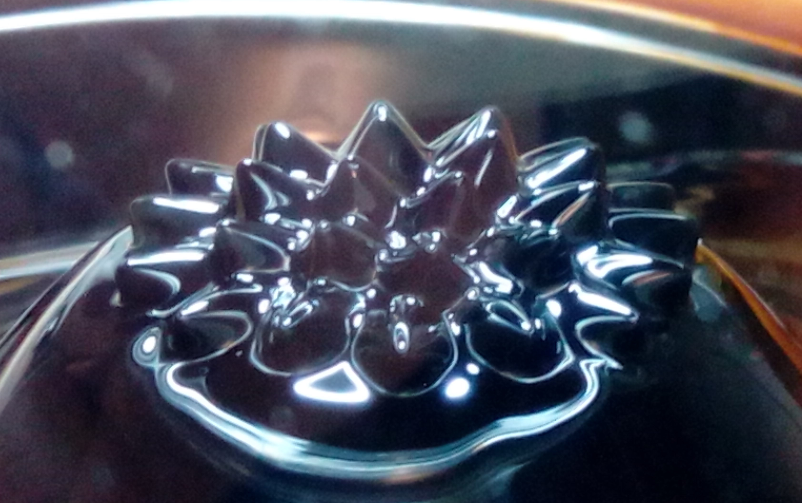
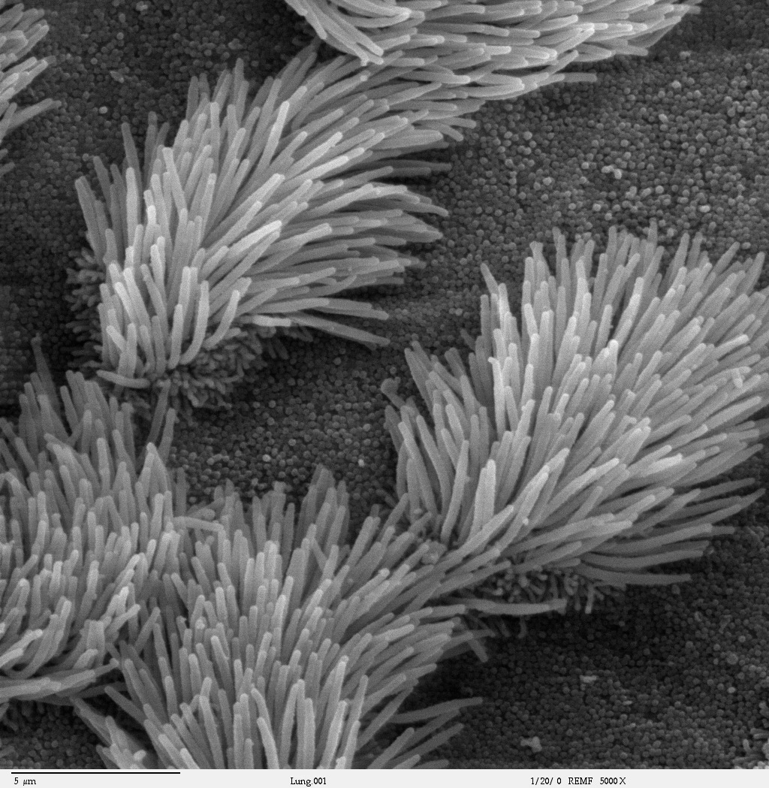
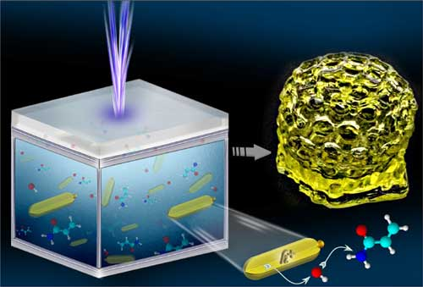
HOW CAN WE MAKE THIS PROCESS SIMPLER?
3
Nanoparticles can either be magnetic or optically active.
Smart materials – artificially made materials that when introduced to a form of stress (magnetic field, light, chemical compounds, etc.), the materials will react.
Aldrich, A. Z. Assembling the Facts of Cilia Assembly and Function https://today.uconn.edu/school-stories/cilia-function/# (accessed Feb 21, 2020).
Dunbar, B. International Space Station’s 3-D Printer Hybrid nanoparticle photoinitiator for 3D-printing in water (nanowerk.com) (accessed Feb 21, 2019).
Ferrofluid https://www.notebookcheck.net/ (accessed Mar 5, 2021).

Slide 4
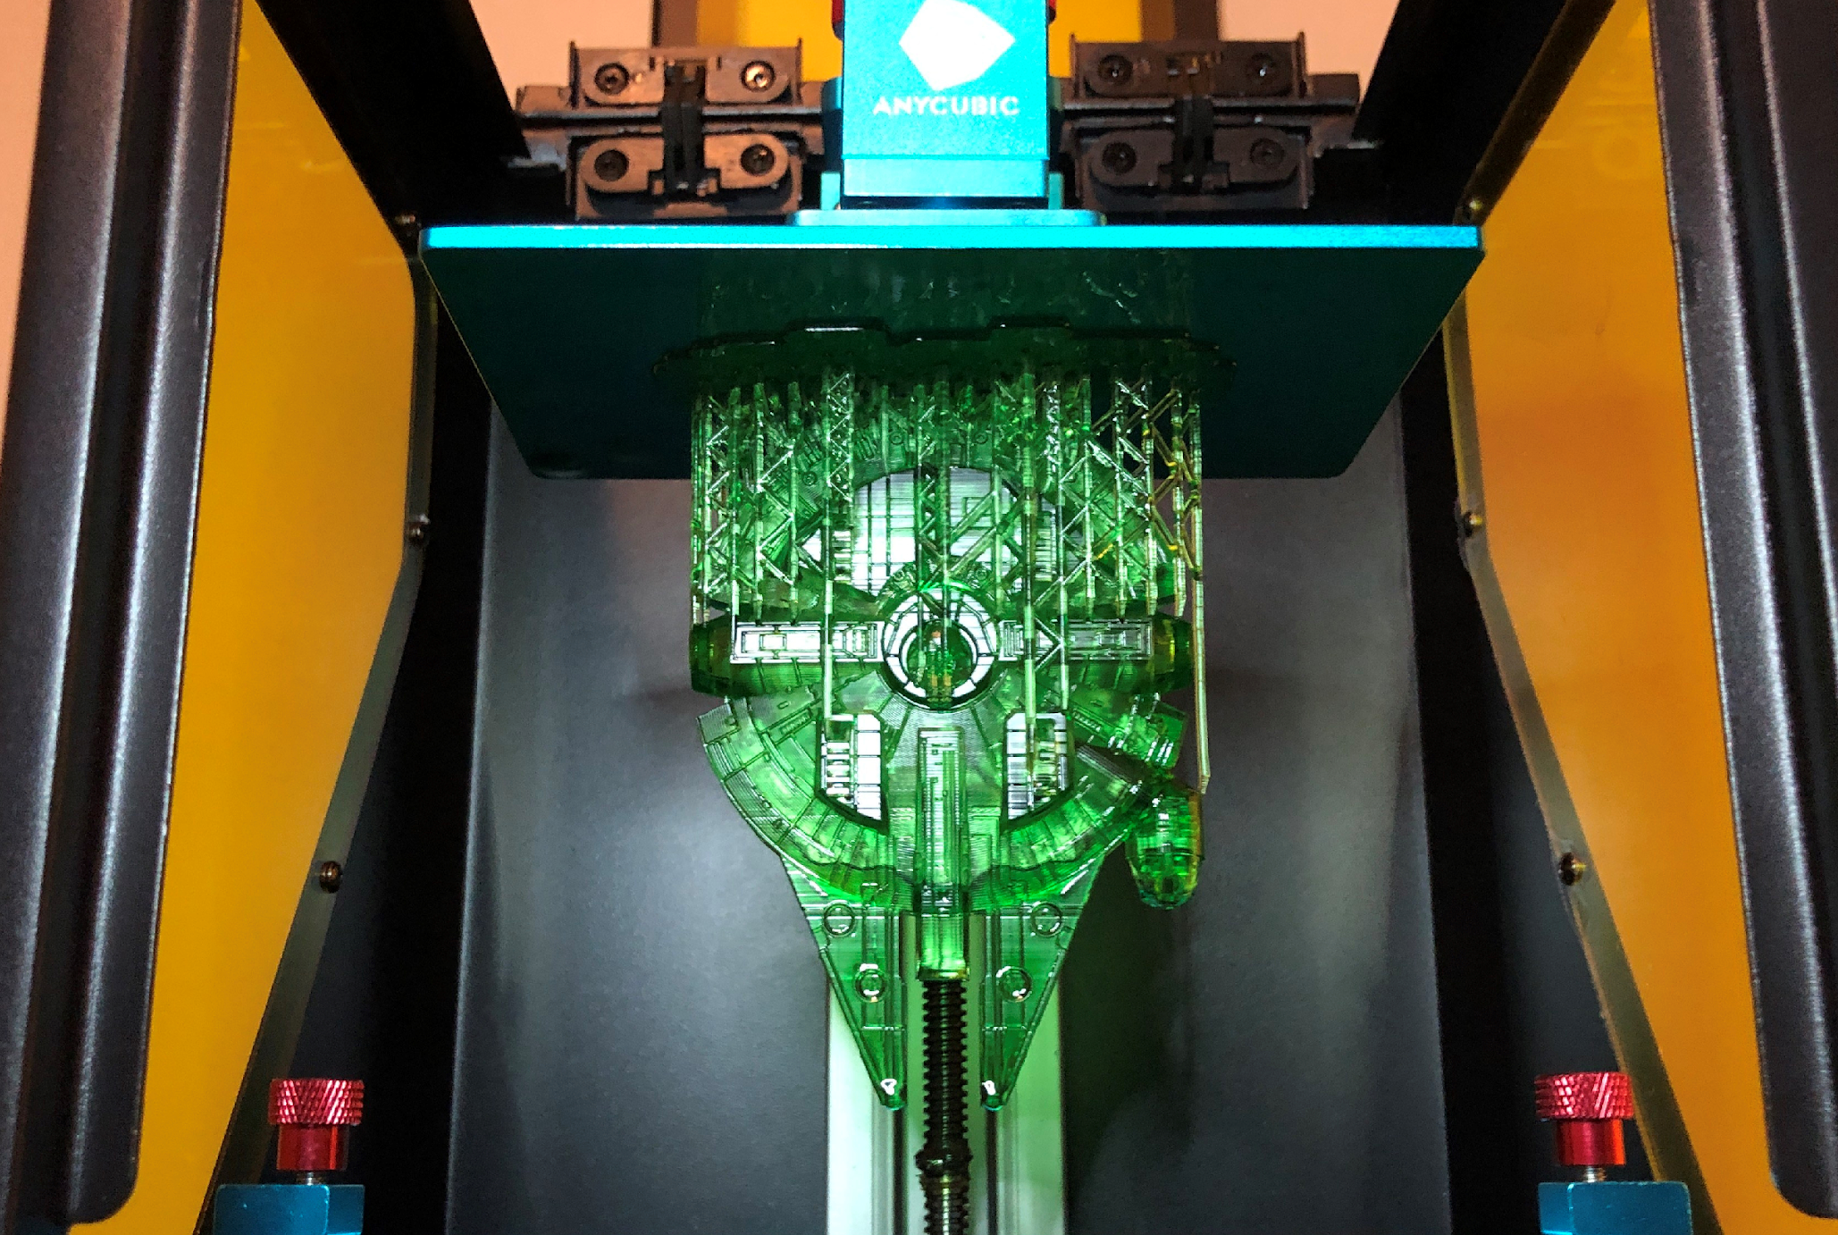
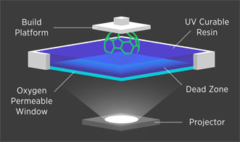
PRINTING WITH RESIN INFUSED WITH NANOPARTICLES
4
Issues that can arise while printing with nanoparticles include possible light dispersion and poor design in structures, as well as expense.
Biehler, J. A Week with the Anycubic Photon resin 3D printer https://johnbiehler.com/2019/01/29/a-week-with-the-anycubic-photon-resin-3d-printer/ (accessed Feb 21, 2020).
Additive Manufacturing Research Group https://www.lboro.ac.uk/research/amrg/about/the7categoriesofadditivemanufacturing/vatphotopolymerisation/ (accessed Feb 21, 2020).

Slide 5
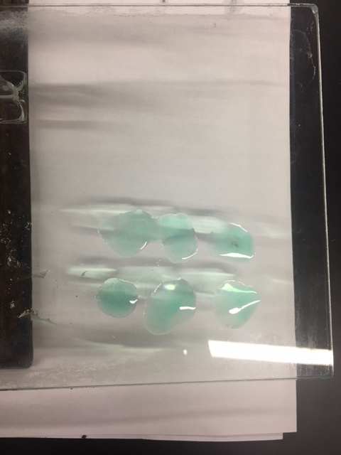
THE NUMBER ONE ISSUE WAS RESIN BEING TOO HARD AND BRITTLE…
5

Slide 6
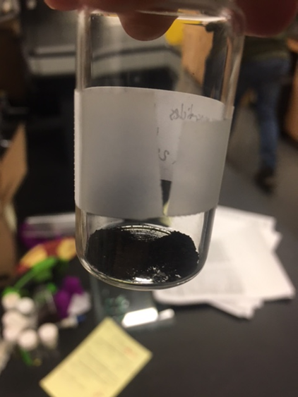
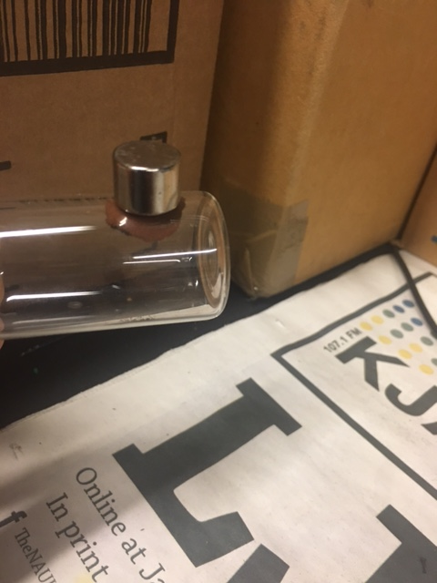
TO FIX THIS ISSUE…
6
…we synthesized our very own optical (left) and magnetic (right) nanoparticles! This makes the process of infusing resin with nanoparticles much easier!

Slide 7
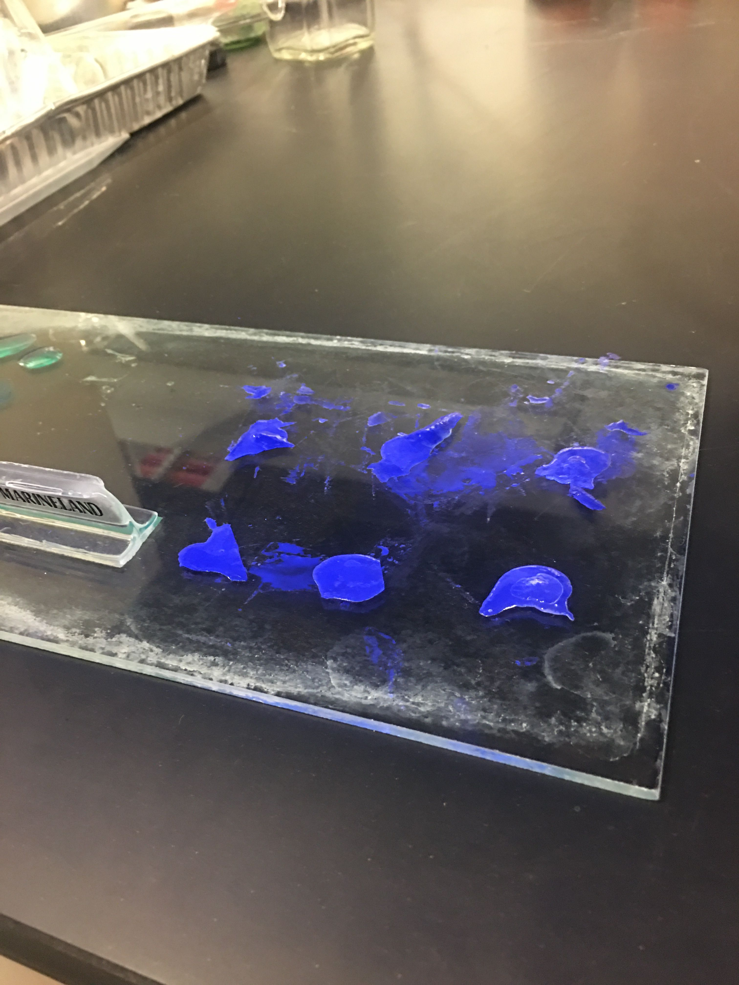
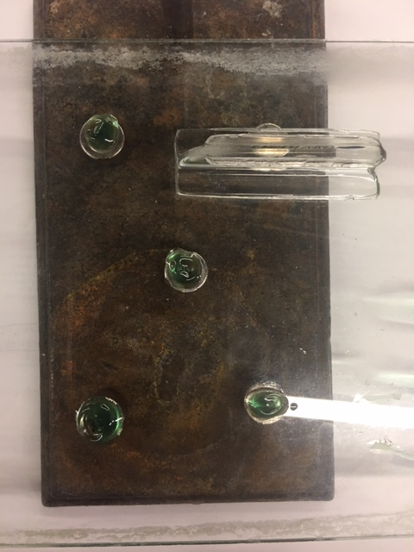
…INFUSING MNP’s AND CURING WITH UV LIGHT DID THE TRICK!
7

Slide 8
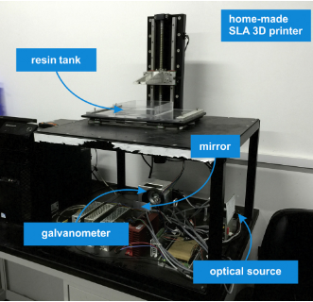
IN THE FUTURE, WE PLAN TO PRINT MORE COMPLEX STRUCTURES WITH NANOPARTICLES
8
The addition of magnetic nanoparticles could provide a source for the light to scatter...this would not be good for printing purposes.
Weng, Z.; Zhou, Y.; Lin, W.; Senthil, T.; Wu, L. Structure-property relationship of nano enhanced stereolithography resin for desktop SLA 3-D printer. Comp. Part A: App. Sci. and Manufacturing, 2016, 88, 234-242.
Notes:
The starch that is present in potatoes serves as the reaction medium and as a reducing agent.

Slide 9
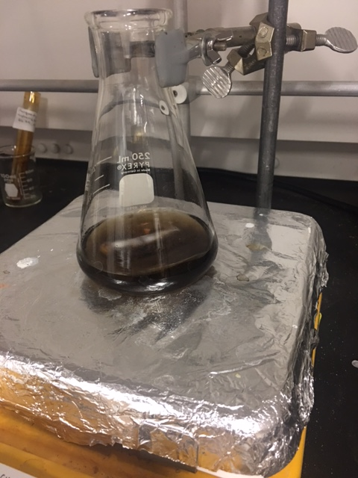
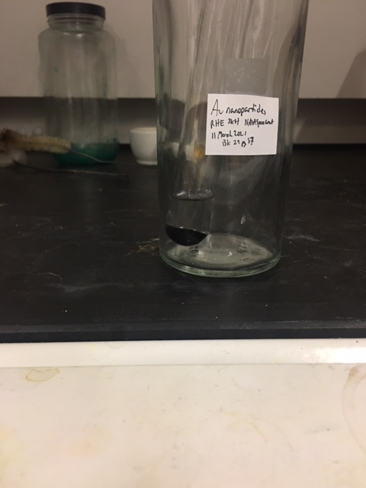
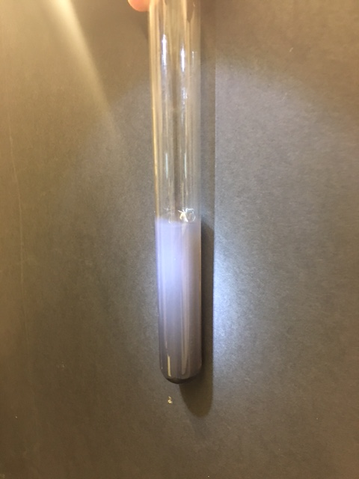
PREVIOUS RESEARCH SHOWS SOME TECHNIQUES ARE REQUIRED FOR SEPARATION!
9
These images instill great confidence that nanoparticles want to become homogeneously mixed with solution, especially after sonication!
Chemical procedures were as follows:
HAuCl₄+H₂O+MSA+NaBH₄→Au⁰ (gold nanoparticles)
FeCl₂+FeCl₃+H₂O+NaOH→α-Fe₂O₃ (iron nanoparticles)

Slide 10
ACKNOWLEDGMENTS
10
Funding for this project was provided through the NAU/NASA Space Grant Undergraduate Research Scholarship Program. Thank you to Paloma Davidson and Dr. Nadine Barlow for your guidance on our presentations.
Thank you to Dr. Stephanie Hurst for accepting me into her research group and encouraging me as a chemist. I want to thank my laboratory partners Jarrett Posz, Patrick Cross, Zachary Brown, Justin Case, Andrew Foss, and Laura Vazquez.

